Slide 1
Phishing Awareness Training
Information Technology
Information Security Team

Slide 2

What is Phishing?
phish·ing
Pronounced: /ˈfiSHiNG/
noun - the fraudulent practice of sending emails purporting to be from reputable companies in order to induce individuals to reveal personal information, such as passwords and credit card numbers.
Source: Google Dictionary

Slide 3


Spear Phishing
A type of phishing attack that targets specific individuals or organizations typically through malicious emails.
The goal of the attack is to steal sensitive information such as login credentials or infect the targets’ device with malware.
Emails, texts or phone calls are highly personalized for a specific organization or individual.
Attacks are more likely to deceive potential victims due to the amount of research and time spent personalizing messages that appear to be from legitimate senders.
Source: https://www.crowdstrike.com/

Slide 4

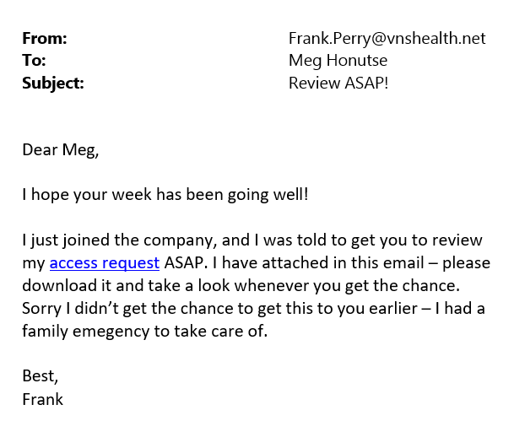
Common Red Flags of Spear Phishing
Some common red flags of a spear phishing attempt:
Incorrect email address
Unusual sense of urgency
Spelling or grammar mistakes
Contains Links that Don’t Match the Domain
Asks for Sensitive Information
Includes Unsolicited Attachments
Tries to Panic the Recipient
Source: https://www.crowdstrike.com/

Slide 5
How do attackers use phishing?
Attackers send emails containing malicious links or attachments to persuade an email recipient to click or open them.
The links or attachments point the user to malicious websites where malicious software (malware) can be run or downloaded.
The websites may look legitimate and request that the user enter their username and password credentials – which are then captured by the attacker.
Once the credentials are obtained, the attacker can use the username and password to gain remote access to a system.

Slide 6
What can the attacker get from phishing?
Gain remote access to a system or network.
Gain the ability to download and execute more malicious software, such as ransomware.
Gain access to all the resources (email, files, applications, etc.) that the recipient had access to.
Gain the ability to perform tasks that the user could do.
Gain the ability to pose as the user to further the attacker’s goals.
Gain the ability to destroy or disrupt a system.
Gain the ability to commit fraud, sabotage, or other illegal actions.

Slide 7
What does I.T. do to prevent phishing?
Performs some checks on the validity of a sender.
Scans incoming mail for known and probable malware.
Scans incoming mail for references to known and probable malicious websites.
Quarantines known spam messages.
Looks for inconsistencies in names and email addresses.
Warns users that a message came from an external source.
(Coming soon!) Requires multifactor authentication for to access email on unrecognized devices.

Slide 8
Watch out for this warning!
The warning below will be displayed on any external email. If someone or a department is sending from within VNS Health’s mail system, you should not see this warning. Be sure to pay attention to it!

Slide 9
Tips – Suspicious Email
So, you have received a suspicious email! Here’s what to do:
Identify the sender. Don’t rely upon the sender’s name which can be spoofed – check the email address. If the email address does not match what you have for the sender, it may be malicious. If the email address does not end in “@vnshealth.org”, it did not come from our systems.
Heed the warning above. If you see the warning message above on a message that purports to be from a VNS Health individual or department, take special care to validate the message before clinking links or opening attachments.
Were you expecting the message? If an email message is from someone that you know, but the message does not make sense in the context of your professional relationship, call the sender to validate that the message was intended.

Slide 10
Tips – Suspicious Email
So, you have received a suspicious email! Here’s what to do (cont’d):
Check the format. Did you get a newsletter message from VNS Health or a trusted partner, but the format (fonts, layout, content) is not consistent with previous messages? Don’t trust it. Call the sender or department to validate.
Did you receive a “secure message” that asks you to log in? Often spammers will send messages that are crafted to look like valid secure messaging portals. If you were not expecting a secure message from that sender, validate by emailing, calling or texting the sender directly.
Mouse-over the links. By simply pointing (but not clicking) on links in an email, Outlook should show you the destination of the link. If the destination is not one that you expect, do not click it.

Slide 11
Tips – Suspicious Email
So, you have received a suspicious email! Here’s what to do (cont’d):
Still unsure? Report it to I.T. The Self-Service Portal has a form for reporting suspicious email. Here is the form. Select “Report an Issue.”
Err on the side of security. Any suspicious email message that cannot be validated by phone, text, or other means should be ignored or reported to I.T. using the Report Message button.
Oops, you clicked the link or attachment! What now? Change your password immediately and contact I.T. Support. We all make mistakes. I.T. is armed with additional tools to validate your whether your computer was compromised and can advise you on what to do next.

Slide 12
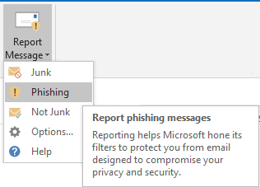
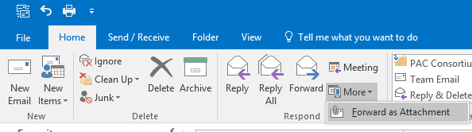
Tips – Suspicious Email
You have received a phishing email. What do you do now?
Use the Report Message as Phishing Button in Outlook
Forward as an attachment to phish@office365.Microsoft.com
Click here for more information on using the Report Message Button.

Slide 13
Phishing Awareness Training Revised February 2023
Justin Bain, CISSP, HCISPP Vice President, Information Security Officer
Information Technology
infosec@vnshealth.org

